Slide 1

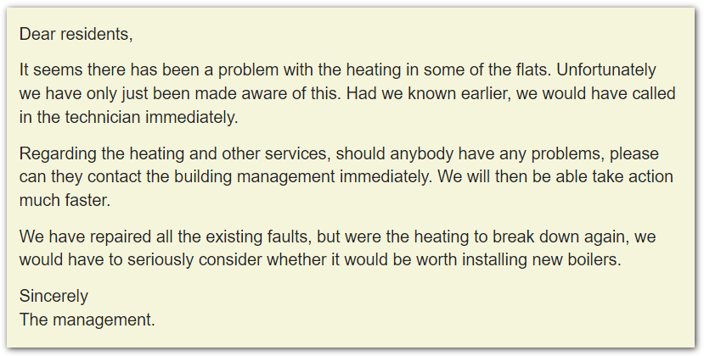



What problems did the residents have?
Why haven't the building management already done something about it?
What should residents do?
What is the management company's future contingency plan?
Now

Slide 2
To all employees
I regret to say that we have recently had to take disciplinary action against two employees for stealing company funds. Had it not been for the security cameras, we might never have known who the culprit was.
Unfortunately, it appears as though one of these employees was having some financial difficulties at home. As you know, we have special arrangements to help employees in such situations, and had the person concerned been to see Jennifer in HR, she might well have been able to help.
I realise that conditions are difficult for many of you at the moment, and were any of you to find yourself in similar circumstances, I would strongly advise you to arrange to see Jennifer as quickly as possible.
Sincerely
Peter Parker
What did the employees do?
What are funds?
How did the employer find out?
What do you think will happen to the employee?
What should the employee have done?
Now
stealing from the company,...

Slide 3
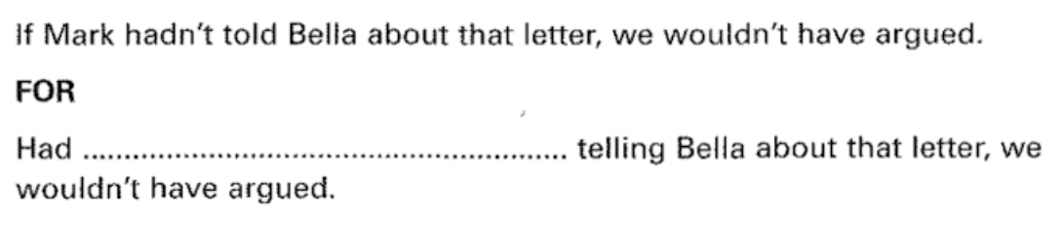
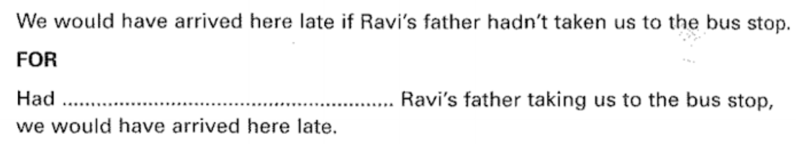
If he apologised tomorrow, I wouldn't accept it.
TO
Were ……………………….…. Tomorrow, I wouldn’t accept it
Proposal/Report
CONCLUSION
If we were to implement these changes, not only would it benefit our clients but it would also in turn provide a conducive working environment.
Essay
If we were to deprive children of stories, not only would this negatively impact their creativity but it would also prevent them from developing morality.

Slide 4
